Slide 1

RECIPE FINDER WEBSITE
A MINI PROJECT REPORT
Submitted by
Group:G22
Saksham Bharat(2410991721)
Sargunjot Kaur (2410991723)
Siya Aggarwal(2410991730)
In partial fulfilment for the award of the
degree of
BACHELOR OF ENGEINEERING
in
CSE
CHITKARA UNIVERSITY
CHANDIGARH-PATIALA NATIONAL HIGHWAY
RAJPURA(PATIALA) PUNJAB-140401(INDIA)
Sept-Oct,2024

Slide 2
ABSTRACT
“The Recipe Finder website” is a user-centric platform designed to simplify the culinary experience for home cooks and food enthusiasts. By leveraging an intuitive search engine, the site allows users to explore a diverse database of recipes based on ingredients, dietary preferences, cuisine types, and cooking techniques. With features such as personalized meal planning, step-by-step cooking guides, and user-generated reviews, the platform fosters a vibrant community of food lovers. The Recipe Finder aims to inspire creativity in the kitchen, reduce food waste by promoting the use of available ingredients, and accommodate various dietary needs. Through its seamless design and robust functionality, the website transforms the way individuals discover, share, and enjoy recipes, making cooking accessible and enjoyable for everyone.

Slide 3
TABLE OF CONTENT
Sr . No. | Sections | Page No.
1. | Introduction | 4
2. | Problem Statement | 5-6
3. | Scope | 7
4. | Key Features | 8
5. | Project Highlights | 9-16
6. | Conclusions | 17
7. | References | 18
8. | Thank You | 19

Slide 4
INTRODUCTION
The website “ MEALMAP” is basically a recipe finder website which discovers a world of flavours with our extensive collection of recipes from various cuisines , designed to inspire your culinary creativity.
Easily find recipes based on ingredients, dietary restrictions, cooking time, and meal types, making meal prep efficient and enjoyable.
Receive tailored recipe suggestions based on your preferences and past cooking experiences, ensuring you always find something you'll love
Navigate our website effortlessly with an intuitive design that makes browsing and searching for recipes a breeze.
Utilize our meal planner feature to organize your weekly meals, create shopping lists, and streamline your cooking routine.
Access detailed instructions and cooking tips for each recipe, ensuring that even novice cooks can create delicious dishes with confidence.
Join a vibrant community of food enthusiasts, share your own recipes, and exchange tips and reviews with fellow cooks.
Stay updated with seasonal ingredients and popular recipes to keep your meals fresh and exciting throughout the year.

Slide 5
PROBLEM STATEMENT
Ingredient Waste: Many users struggle to find recipes that utilize leftover or available ingredients, leading to unnecessary food waste.
Dietary Restrictions: Individuals with specific dietary needs (e.g., vegan, gluten-free) often find it challenging to locate suitable recipes, limiting their cooking options.
Overwhelming Choices: The vast number of recipes available online can overwhelm users, making it difficult to find quick and easy meal solutions that fit their preferences.
Lack of Meal Planning: Users often face challenges in planning their meals for the week, resulting in last-minute cooking decisions that can be unhealthy or unbalanced.
Inconsistent Nutritional Information: Many recipes lack reliable nutritional details, making it difficult for users to make informed choices about their meals.

Slide 6
Limited Community Engagement: Users may miss out on valuable feedback and inspiration from other home cooks due to a lack of interactive features like reviews and recipe sharing.
Complex Cooking Instructions: Some recipes may contain unclear or overly complicated instructions, discouraging novice cooks from trying new dishes.
Device Accessibility: Users may struggle to access recipes conveniently while cooking due to non-mobile-friendly designs, hindering their cooking experience.

Slide 7
SCOPE
The scope of the Recipe Finder website encompasses a wide range of features designed to enhance the cooking experience for users of all skill levels. It offers a comprehensive database of recipes from various cuisines and dietary preferences, allowing users to search for meals based on available ingredients or specific dietary needs like vegan or gluten-free. Users can create meal plans and shopping lists, making grocery shopping more efficient.
The website fosters community engagement by enabling users to share their own recipes, rate and review dishes, and participate in discussions.
Additionally, it includes seasonal and themed collections for inspiration, as well as cooking tutorials and nutritional information to help users make informed choices. With a mobile-friendly design, the Recipe Finder website aims to be an accessible and versatile resource, making cooking enjoyable and easy for everyone.

Slide 8
KEY FEATURES
SEARCH FUNCTIONALITY: Here you can find recipes by entering ingredients, cuisine types or dietary preferences. Example: Search for ‘vegetarian pasta’ or ‘gluten-free desserts.’
USER REVIEWS: Here you can also read other user reviews to find the best recipes. Example:- “This chocolate cake recipe is amazing! Easy to follow and delicious.” Review from user of recipe finder.
PERSONAL RECOMMENDATIONS : Here you can also get suggestions based on your previous searchers and saved recipes. Example: “Since you liked the chicken curry, you might enjoy these other Indian dishes.
CUISINE FILTER : Allow users to explore recipes from various cuisines around the world. Example:- search cuisines from different countries and try them like Italian , Indian etc.
RESPONSIVE DESIGN: Ensure the website is mobile friendly for easy access and usability on any device.
SEASONAL AND THEMATIC COLLECTIONS: Curate special collections based on seasonal ingredients , holidays , or trending cuisines.

Slide 9

PROJECT HIGHLIGHTS
LOGO OF WEBSITE:

Slide 10
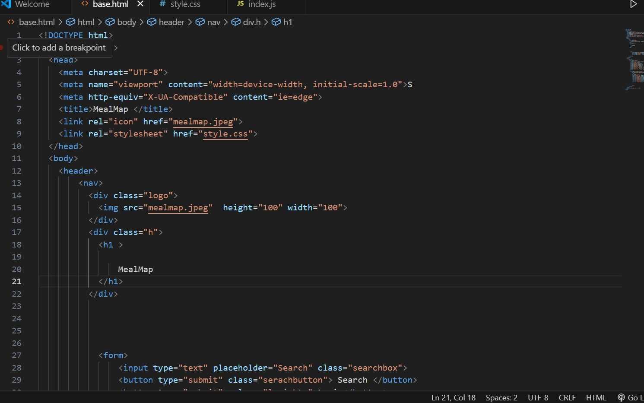
HTML CODES:

Slide 11
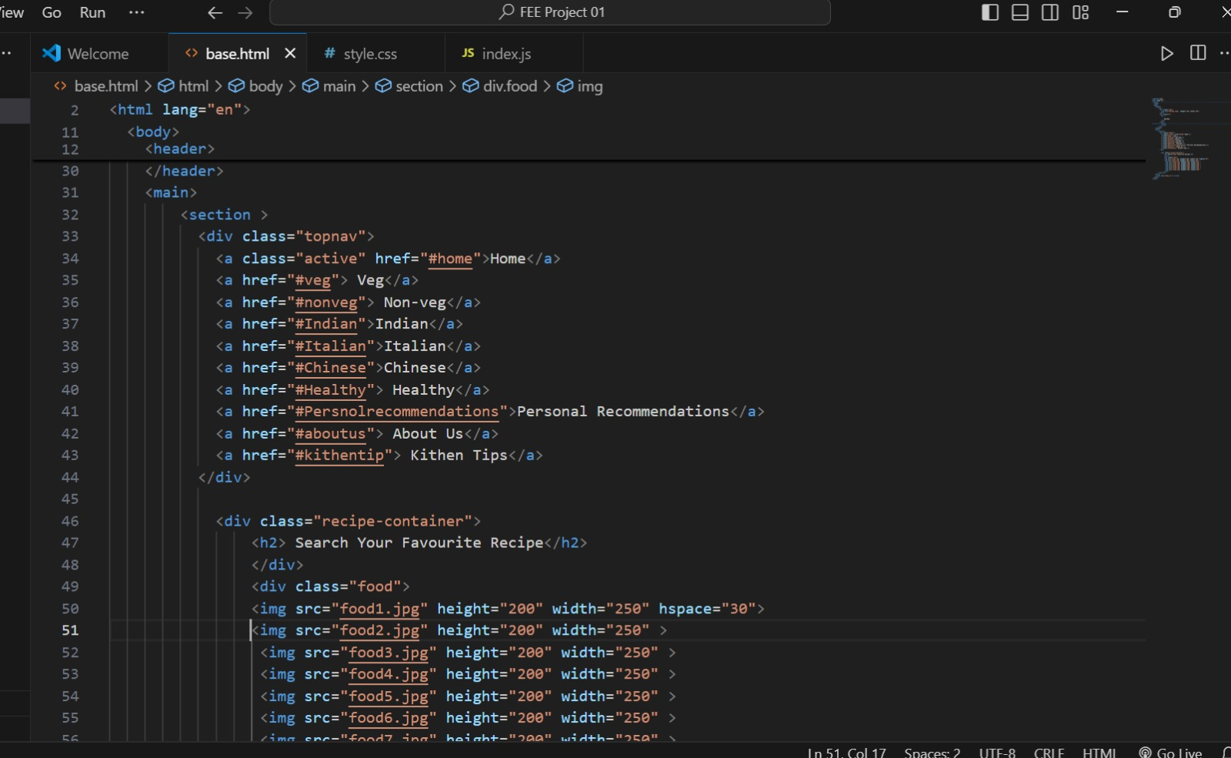

Slide 12
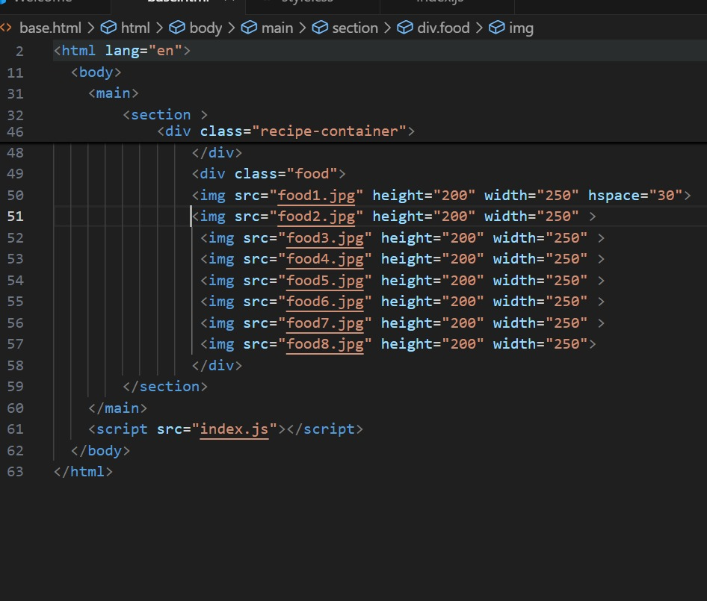

Slide 13
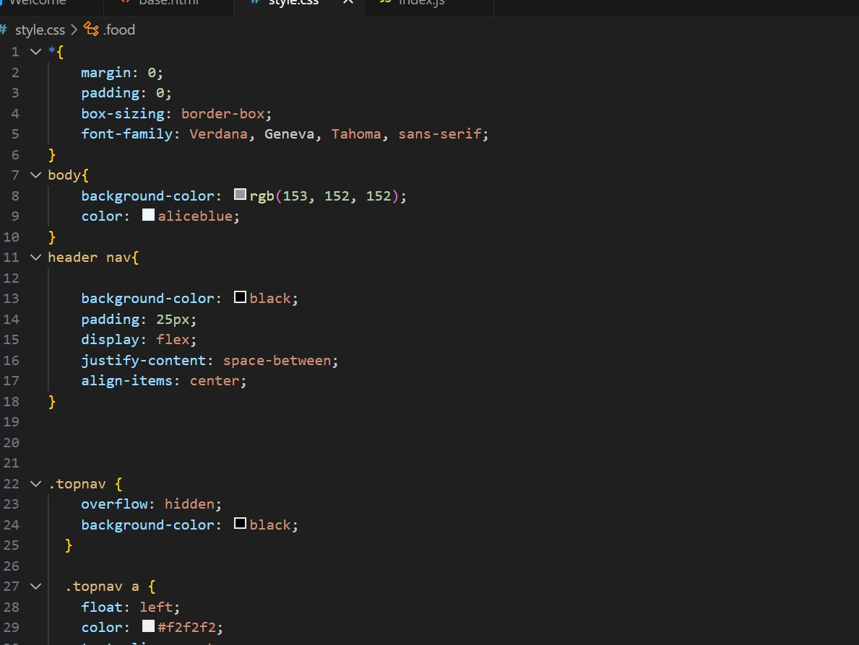
CSS CODES:

Slide 14


Slide 15
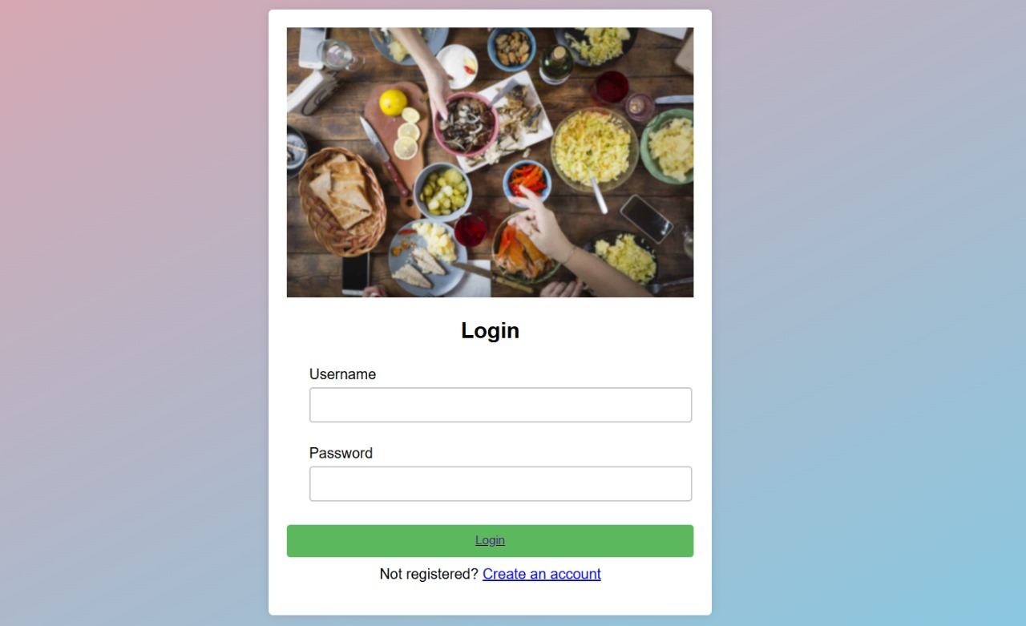
LOGIN PAGE:

Slide 16
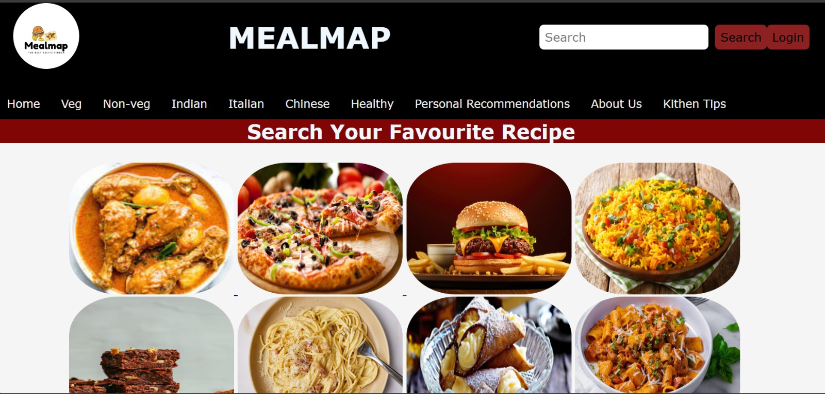
HOMEPAGE OF WEBSITE:

Slide 17
CONCLUSION
In conclusion, the Recipe Finder website stands out as a comprehensive and user-centric platform designed to enhance the cooking experience for users of all backgrounds. Its user-friendly interface ensures that even those with minimal tech skills can navigate the site effortlessly. The real-time updates keep the recipe database fresh and relevant, while mobile compatibility allows for convenient access on various devices. Customization features empower users to tailor recipes to their preferences and available ingredients, promoting creativity in the kitchen. Additionally, the provision of nutritional information supports healthier cooking choices, and the diverse range of cuisine options caters to a wide array of tastes. Together, these features create a rich and engaging environment, making the Recipe Finder an essential resource for anyone looking to explore new recipes and improve their culinary skills.

Slide 18
REFERENCES
GOOGLE
FOODPAIR
YOUTUBE
CHATGPT
SUPERCOOK

Slide 19


